Slide 1
The path to decarbonization for Applied HVAC Systems
Part 1: Overview
Presented by: Jeff Seewald, HVAC Systems Business Development Manager
DISCLAIMER: This presentation is intended only for educational purposes and does not replace independent professional judgment and/or legal advice.
This presentation is copyrighted and cannot be used without the express permission of Daikin Applied Americas Inc.

Slide 2




Introductions
Jeffrey Seewald, PE, CEM
HVAC Systems Business Development Manager
jeffrey.seewald@daikinapplied.com
Joined Daikin in November 2023
30 years of experience
    HVAC equipment and systems
    Building automation and controls
    Energy efficiency and infrastructure renewal
Focus areas at Daikin include:
    Decarbonization
    Refrigerants
    Electrification and heat pumps
    Energy efficiency
    Indoor air quality

Slide 3
Disclaimer
This content subject to change without notice and is intended only for educational purposes and does not replace independent professional judgment and/or legal advice. The ultimate responsibility is on the engineer of record to ensure the design complies with all applicable codes and Daikin Applied will not accept responsibility or liability for actions that result from the information shared in this presentation. This content is copyrighted and cannot be used without the express permission of Daikin Applied Americas Inc.
Always consult your state & local codes, which may take precedence over standards which vary in adoption, complete or partial, by state. Also note that a state may adopt a different year of the standard than the latest version.
The local Authority Having Jurisdiction (AHJ) has the final authority in interpreting code requirements.

Slide 4
Agenda
Decarbonization Drivers
Energy & Electricity
Decarbonization
  Refrigerants
  Electrification
  Efficiency
Refrigerants
Low GWP
LCCP
Electrification
Heat pumps
System design & optimization
Efficiency
Load reduction
Ventilation

Slide 5
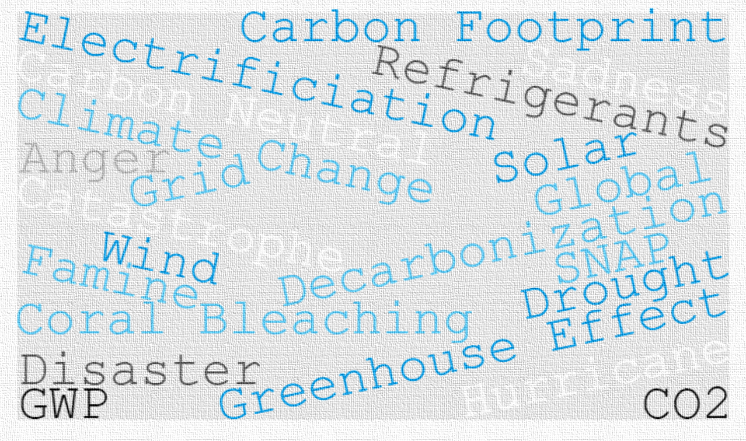

Slide 6
Decarbonization drivers

Slide 7

Addressing Efficiency Needs

Slide 8


Addressing Efficiency Needs
Efficiency-Enabling Technologies
Codes, Standards & Regulations
System & Design Changes
Include:
ASHRAE Standards
  62.1 - IAQ
  90.1 - Energy
  228 - Net zero energy
  240 - GHG emissions
DOE requirements
CA Title 24
Local codes

Slide 9
Addressing Efficiency Needs
Efficiency-Enabling Technologies
Codes, Standards & Regulations
System & Design Changes
Include:
    VFD/inverter compressors
    Permanent magnet motors
    Variable volume ratio compression
    Better and larger heat exchangers
    Integrated ‘free-cooling’

Slide 10
Addressing Efficiency Needs
Efficiency-Enabling Technologies
Codes, Standards & Regulations
System & Design Changes
Include:
More efficient designs
  Load reduction (lighting, insulation, ventilation)
Building recommissioning or energy audits
Systems that share energy within the building or system
  District systems
  Heat recovery
  Heat pumps

Slide 11

Regulations and Legislation Summary

Slide 12

Regulations and Legislation Summary
Federal
State
New administration and changing political landscape
Inflation Reduction Act
  Investment in green infrastructure
AIM Act
  Lower GWP Refrigerants
CHIPs and Science Act
  Invest in MFG for semiconductors and R&D for many items including clean energy
Biden-Harris Federal Building Performance Standards
  Electrify 30% of spaces by 2030

Slide 13
Regulations and Legislation Summary
Federal
State/Local
Building Performance Standards
NYC, Washington, D.C.; St. Louis, MO; and Washington State
Pre-wiring for Electrification
Washington D.C. and Boston
Net-Zero Designs
~11 states with current or future targets
Optimize building efficiency / minimize energy use
Building to generate as much clean energy as it consumes
Gas Bans
Various cities, some legal challenges

Slide 14
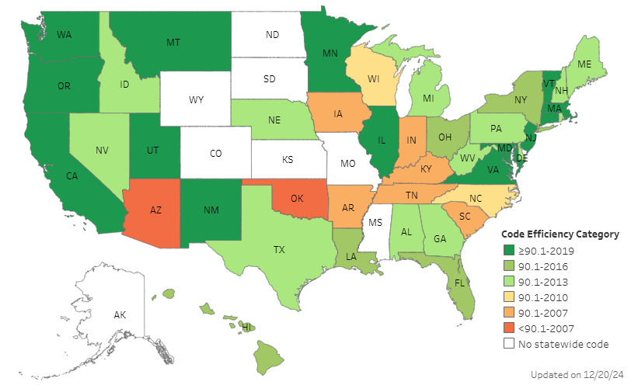

Energy Code Adoption by State
Status of State Energy Code Adoption: Commercial Buildings
Energy code updated in 2024:
Illinois
Minnesota
New Mexico
Ohio
Virginia
Source: US DOE Building Energy Codes Program (January 2025)

Slide 15
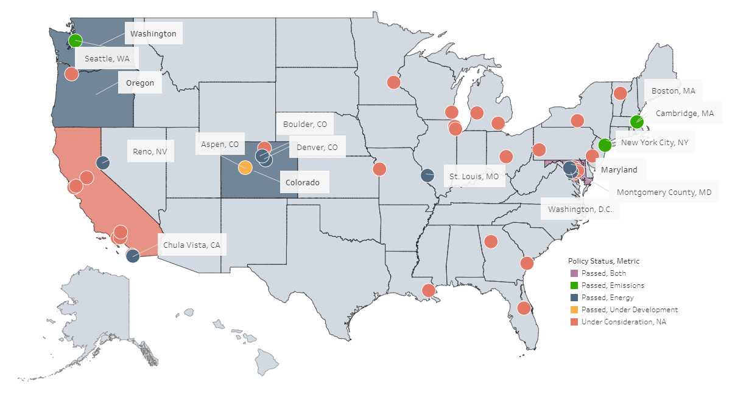
State/Local Building Performance Standards
Source: US DOE Building Energy Codes Program (January 2025)
© 2025 Daikin Applied

Slide 16
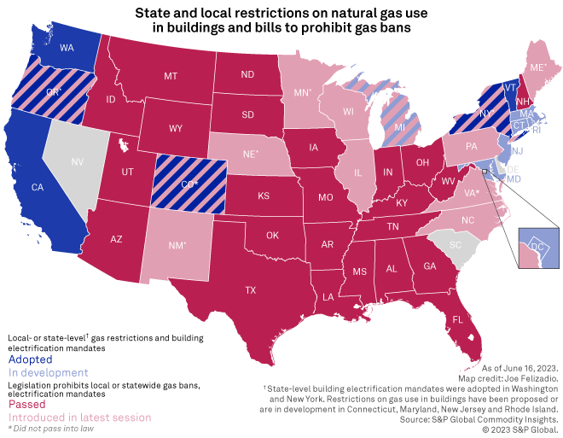
Gas Bans & Gas Ban Bans
ME
WA
MT
ND
VT
MN
NH
OR
NY
MA
WI*
CT
ID
SD
MI
WY
PA
NJ
NE
IA
OH
MD
DE
NV
IL
IN
WV
UT
VA*
CA
CO*
KS
MO
KY
NC*
TE
AZ
OK
AR
SC
NM
GA
MS
AL
TX
LA
FL
© 2025 Daikin Applied

Slide 17










Embodied vs Operational
Embodied
Carbon
Embodied & Operational
Embodied
Carbon
Produce
Build
Use
Deconstruct
Reuse
Including use of refrigerants
Extract/Mine
Transport to Factory
Manufacture
Transport material to site
Construction
Operate building
Maintenance
Tear down
Transport off-site
Dispose
Reuse or recover
Upcycle
Time
ASHRAE Standard 228 (operational focus)
Environmental Product Declarations (EPD’s), ISO 14044, ASTM E2921, EN15978

Slide 18
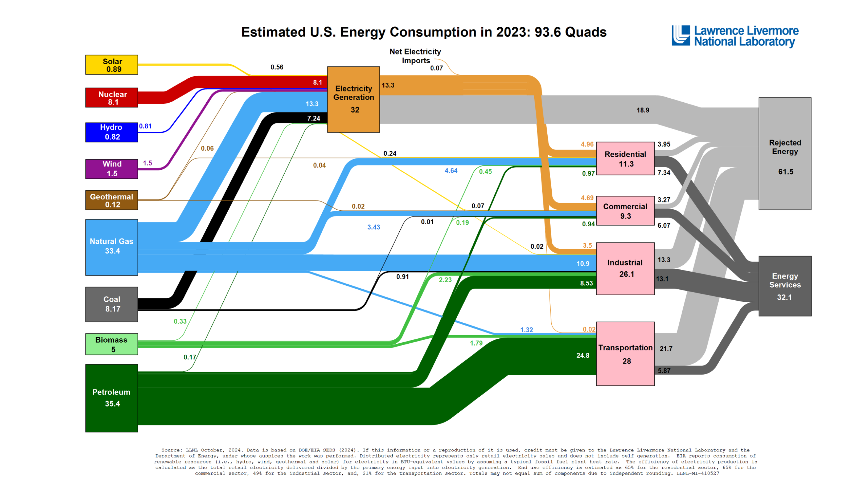
Energy & Electricity

Slide 19
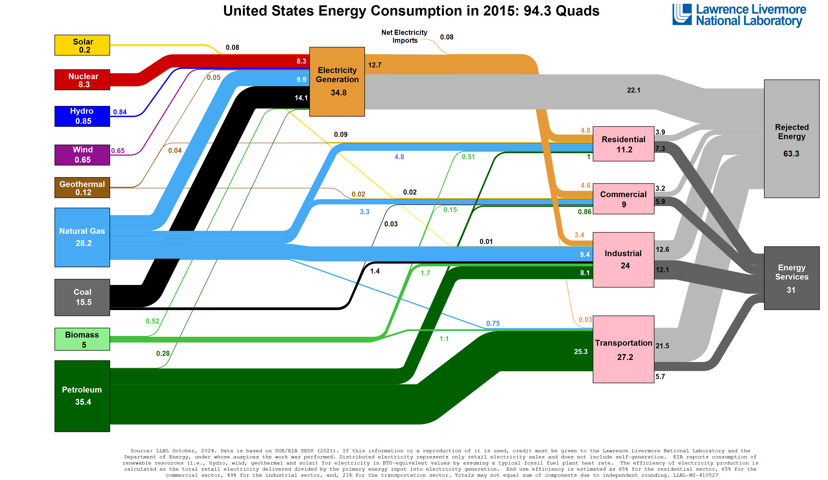


Slide 21
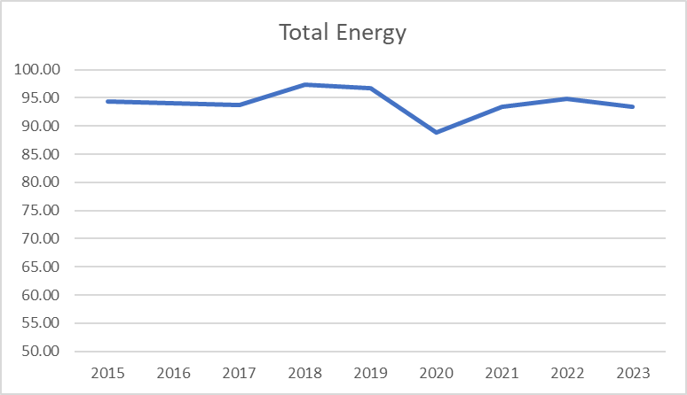
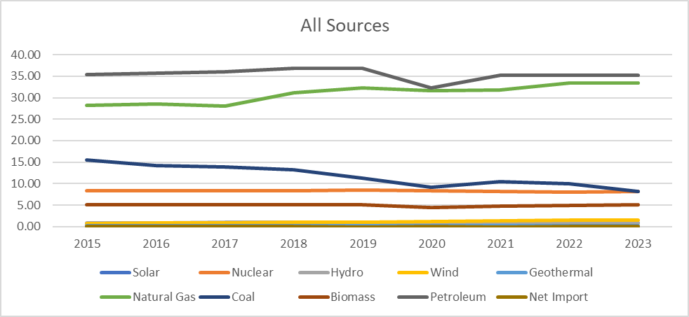
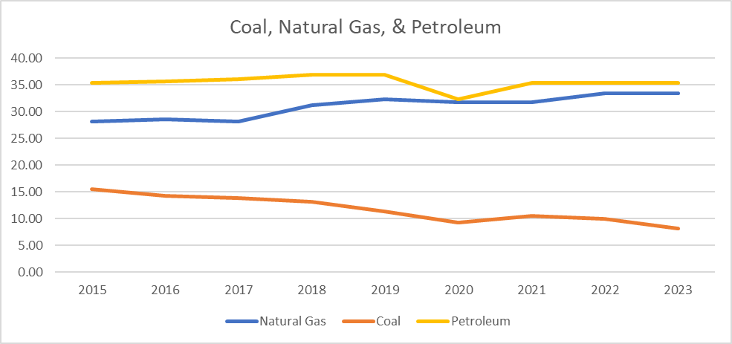
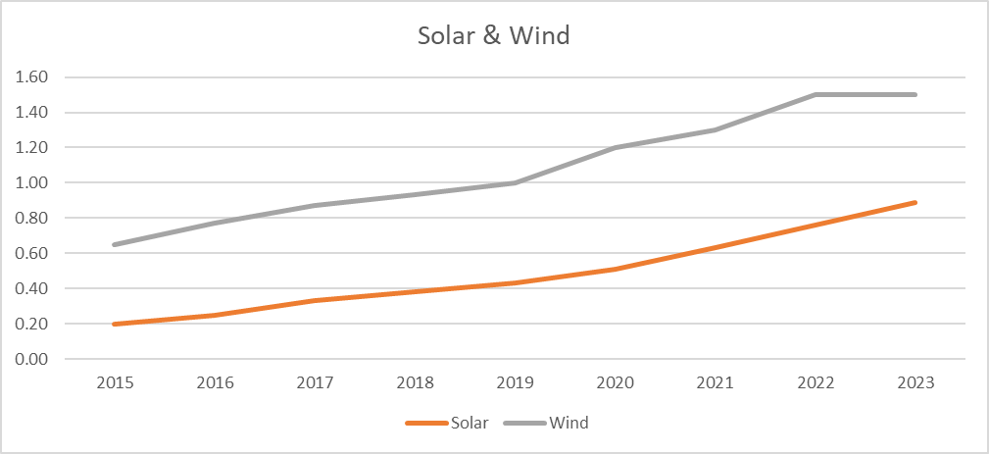
Estimated US Energy Consumption

Slide 22
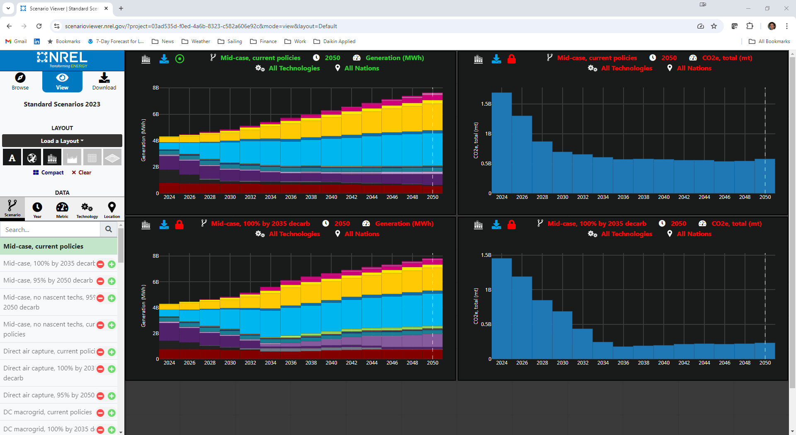

Slide 23
Decarbonization in HVAC
Electrification
Refrigerants
Efficiency
Decarbonization

Slide 24
Decarbonization in HVAC
Electrification
Refrigerants
Efficiency
Decarbonization
Electrification
  Convert fossil fuel equipment/processes to electric
  Dependent on clean power grid

Slide 25
Decarbonization in HVAC
Electrification
Refrigerants
Efficiency
Decarbonization
Refrigerants
  Can have much higher global warming potential per pound than CO₂
  Direct effect: greenhouse effect of the gas
  Indirect effect: change in efficiency changes power usage over equipment lifecycle
  Life Cycle Climate Performance (LCCP): combines direct and indirect effect into one metric

Slide 26
Decarbonization in HVAC
Electrification
Refrigerants
Efficiency
Decarbonization
Efficiency
  Greatest impact with ‘dirty’ grid
  Reduced (but not zero) impact as grid converts to renewable

Slide 27
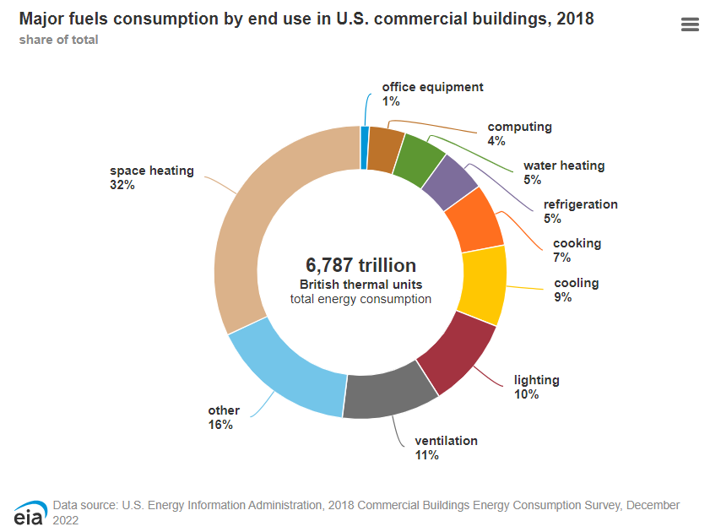
Challenge of Decarbonization
44°F
Cooling
Heat Pump
60°F

Slide 28
Challenge of Decarbonization
130°F
Heating
Boiler
Heat Pump
100°F

Slide 29
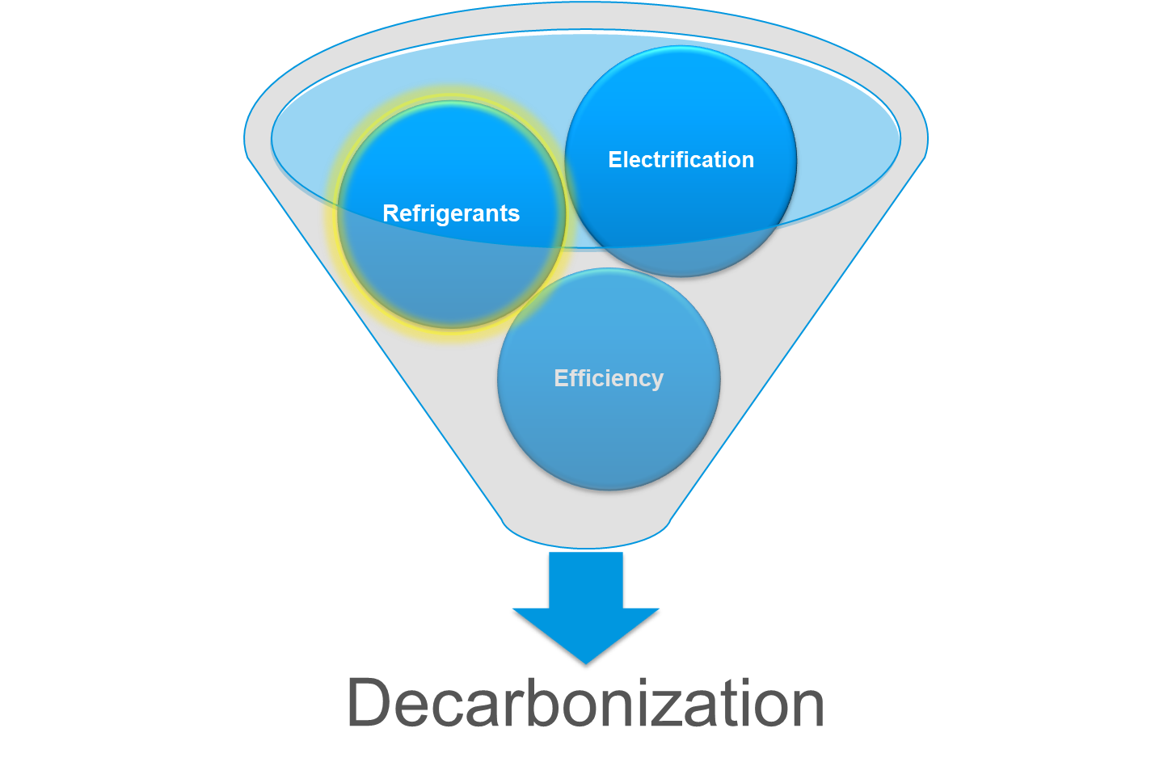

Refrigerants

Slide 30


Global Warming Potential

Slide 31
GWP is Not the Full Measure of Emissions
Direct Effect from Refrigerant
Indirect Effect from Energy Use
Life Cycle Climate Performance
(LCCP)
  Majority of climate impact from HVAC is electrical power generation over equipment lifetime
  A lower GWP refrigerant with lower efficiency could actually create more global warming!
Source: Zhang M., et al. 2011. “Life Cycle Climate Performance Model for Residential Heat Pump Systems.” AHRTI Report 09003-01

Slide 32
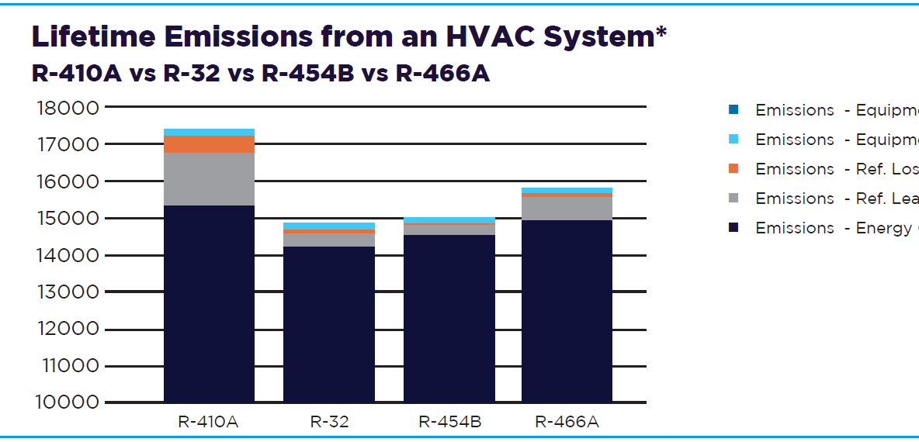
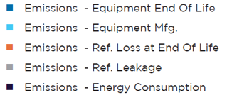
Lifetime Emissions
*Comparison is made using the Life Cycle Climate Performance (LCCP) metric, measured in kg-CO2.eq. LCCP analysis was performed using a high efficiency HP (24+ SEER), using performance gains claimed by respective refrigerant manufacturer, for a residential sized (9000 Btu/h cooling capacity), installed in Houston, TX climate zone, with an assumed annual leakage rate of 4% and end of life refrigerant leakage of 15% with a 15 year lifetime. The heating COP and SEER were adjusted based on refrigerant characteristics and performance. The physical system size, trim charge requirements and capacity were kept consistent to ensure a like-to-like comparison.

Slide 33
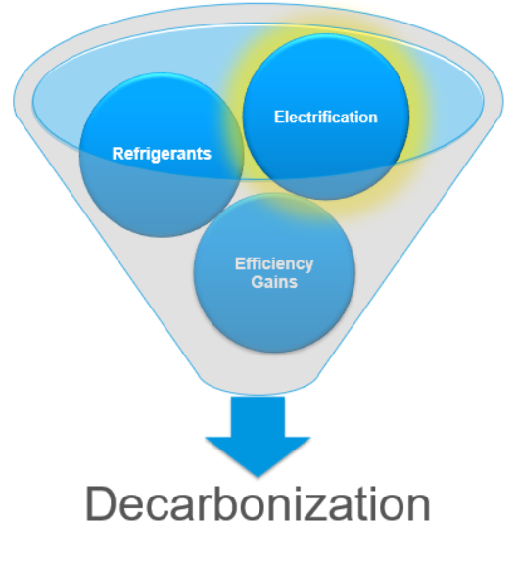
Electrification

Slide 34

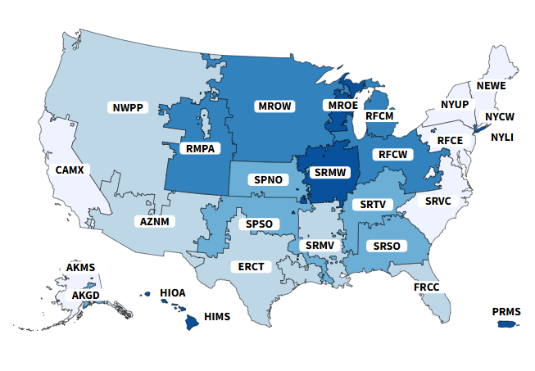
Grid Emissions
Evaluate carbon emissions using grid emissions factors
Grid emissions factors vary by state/region
Grid emissions also vary by time of day
    Marginal emissions factors
Source: US EPA eGRID

Slide 35
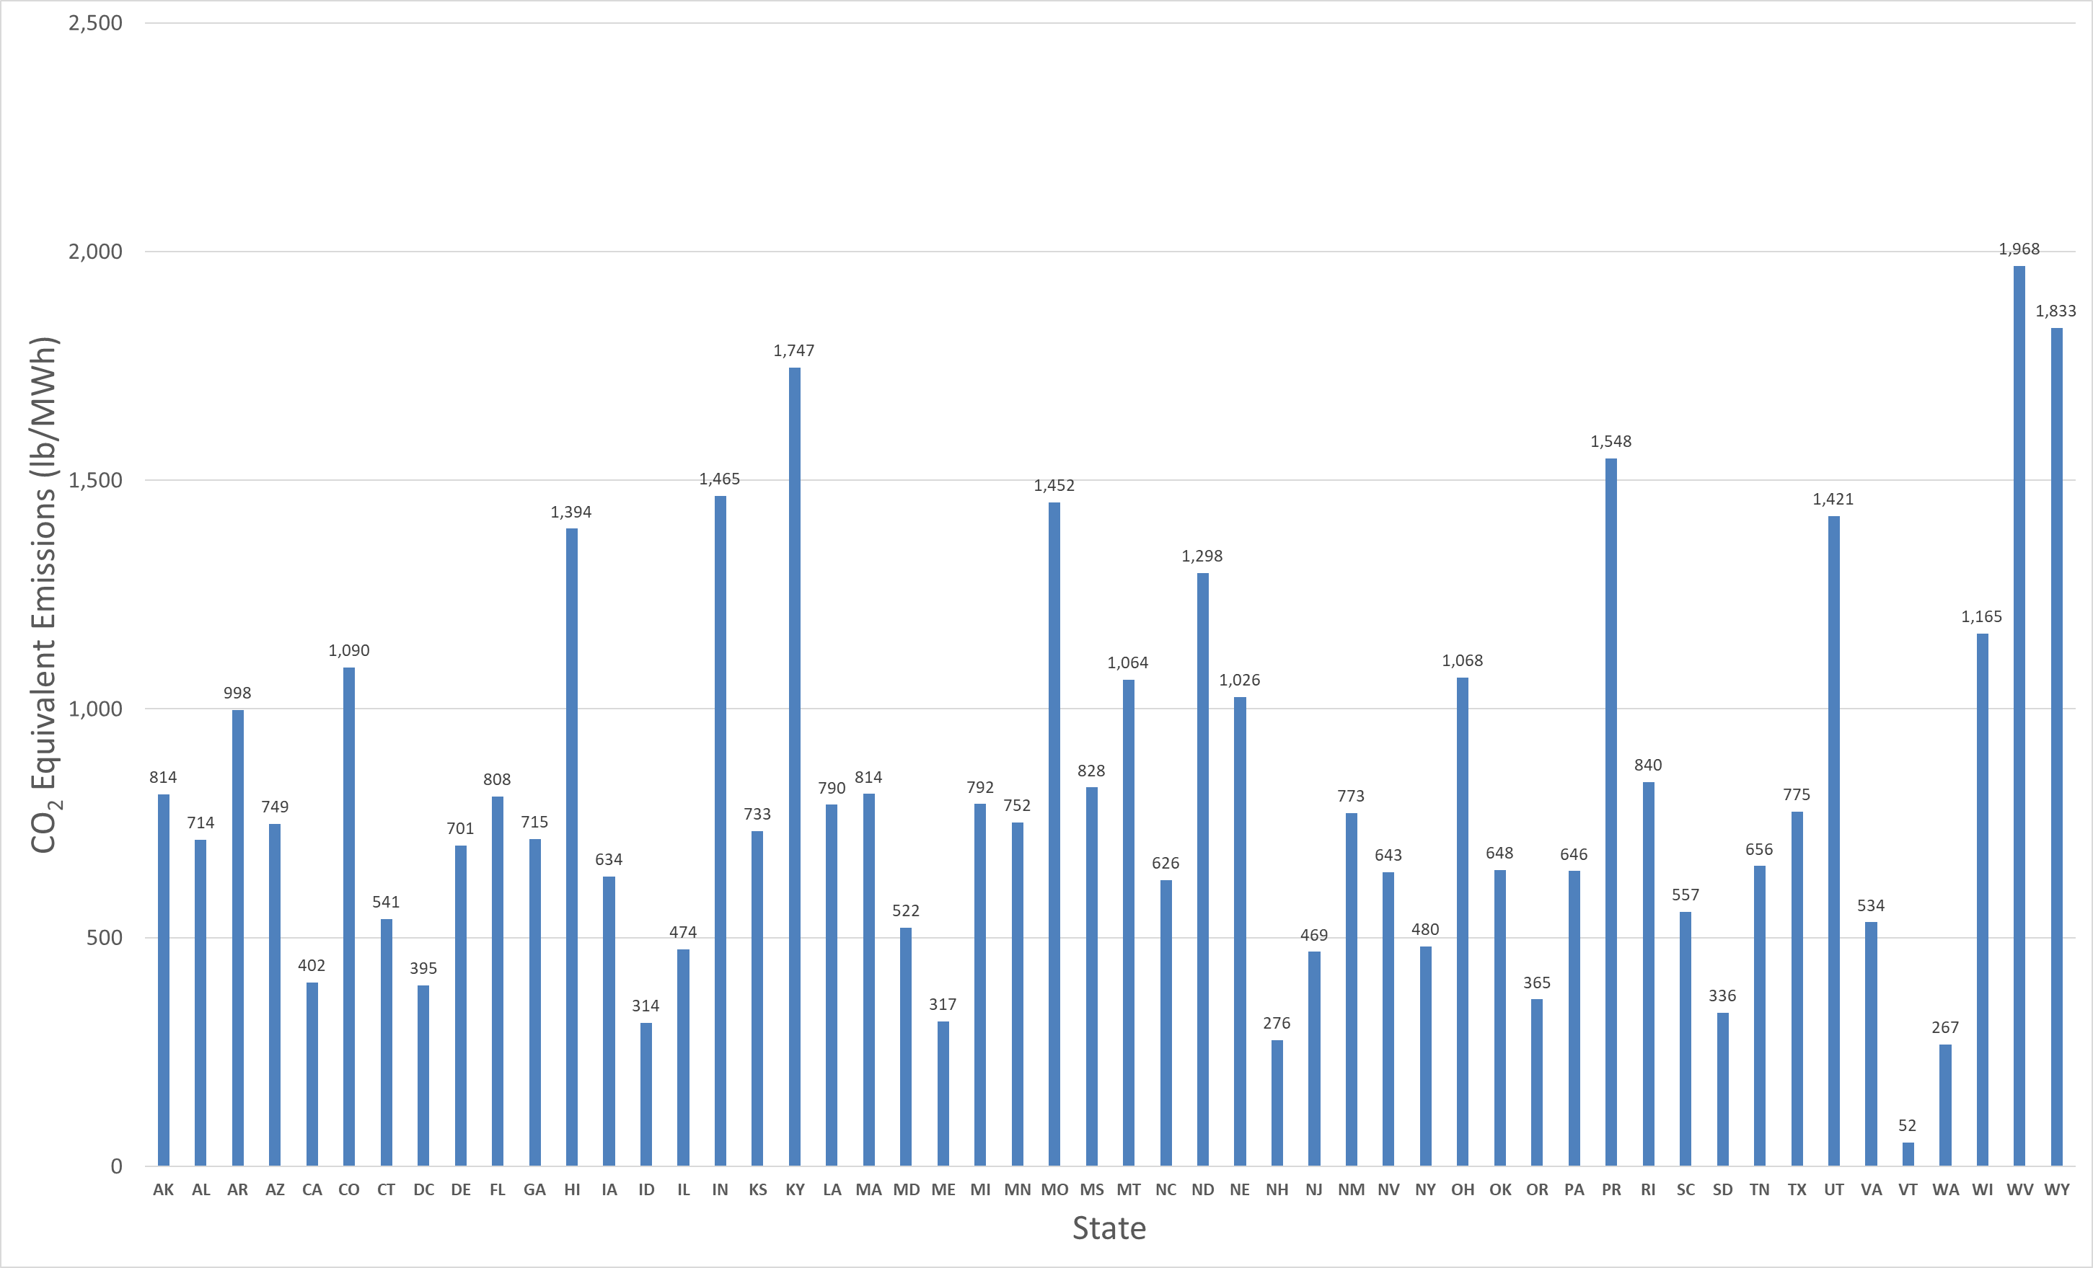
Grid Emissions
Evaluate carbon emissions using grid emissions factors
Grid emissions factors vary by state/region
Use Power Profiler
https://www.epa.gov/egrid/power-profiler#
Source: US EPA eGRID

Slide 36
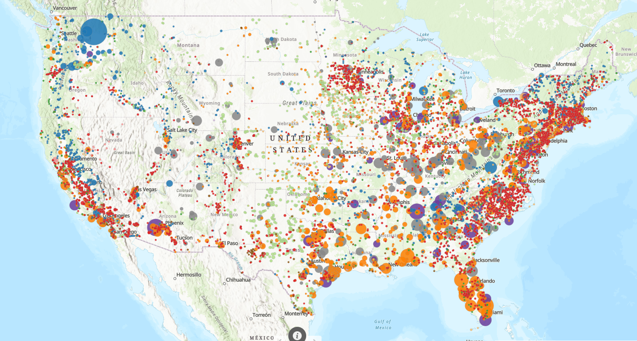
Grid Emissions
Grid emissions vary considerably based on location
MN: 920
WI: 1402
NY: 975
OR: 632
CA: 437
TX: 738
NJ: 595
Source: US EPA eGRID

Slide 37
Heat Pumps
© 2025 Daikin Applied

Slide 38
Types of Heat Pumps
Air to Water
Heat Pump
Water to Water
Heat Pump
Cold
Air In
Hot
Water
Out
Cold
Water
In
Hot
water Out
© 2025 Daikin Applied

Slide 39

Heat Pumps Continued…
Air to Air
Heat Pump
Water to Air
Heat Pump
Hot Air Out
Hot
Air Out
Cool Water In
Cold
Air In
© 2025 Daikin Applied

Slide 40
Applying Heat Pumps
© 2025 Daikin Applied

Slide 41
Air To Water HP Capacity vs Ambient Temperature
Heating Capacity
MBH
Outdoor Air Temperature °F
© 2025 Daikin Applied

Slide 42
Air To Water HP Capacity vs Ambient Temperature
Heating Capacity
MBH
Outdoor Air Temperature °F
© 2025 Daikin Applied

Slide 43
Air To Water HP Capacity vs Ambient Temperature
Heating Capacity
MBH
Outdoor Air Temperature °F
© 2025 Daikin Applied

Slide 44
Supply Temperature vs Ambient Temperature
Max Supply Water Temp.
°F
Outdoor Air Temperature °F
© 2025 Daikin Applied

Slide 45
Supply Temperature vs Ambient Temperature
Max Supply Water Temp.
°F
Outdoor Air Temperature °F
© 2025 Daikin Applied

Slide 46
Supply Temperature vs Ambient Temperature
Max Supply Water Temp.
°F
Outdoor Air Temperature °F
© 2025 Daikin Applied

Slide 47
Selecting Based on Worst Case
Heat Pump
Capacity
OVERSIZED
Heat Load
Outdoor Air Temperature
Lowest Temp.
© 2025 Daikin Applied

Slide 48
Design Conditions
Number Of Hours
Per Each Temperature
Outdoor Air Temperature °F
© 2025 Daikin Applied

Slide 49
Design Conditions
“Don’t let the perfect be the enemy of the good”
1%
99%
Number Of Hours
Per Each Temperature
Outdoor Air Temperature °F
© 2025 Daikin Applied

Slide 50
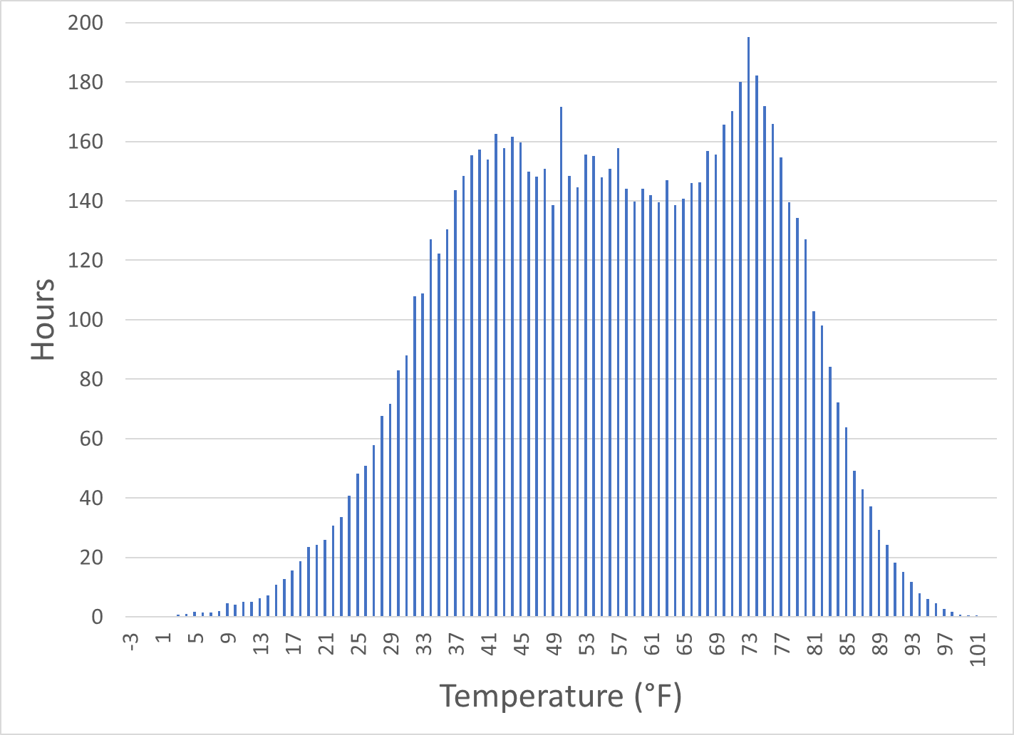
Design Conditions
1.675%
LGA
NY
0.594%
0.047%
20°F
15°F
5°F
Source: ASHRAE Weather Data Viewer, for NY, NY (LGA)

Slide 51
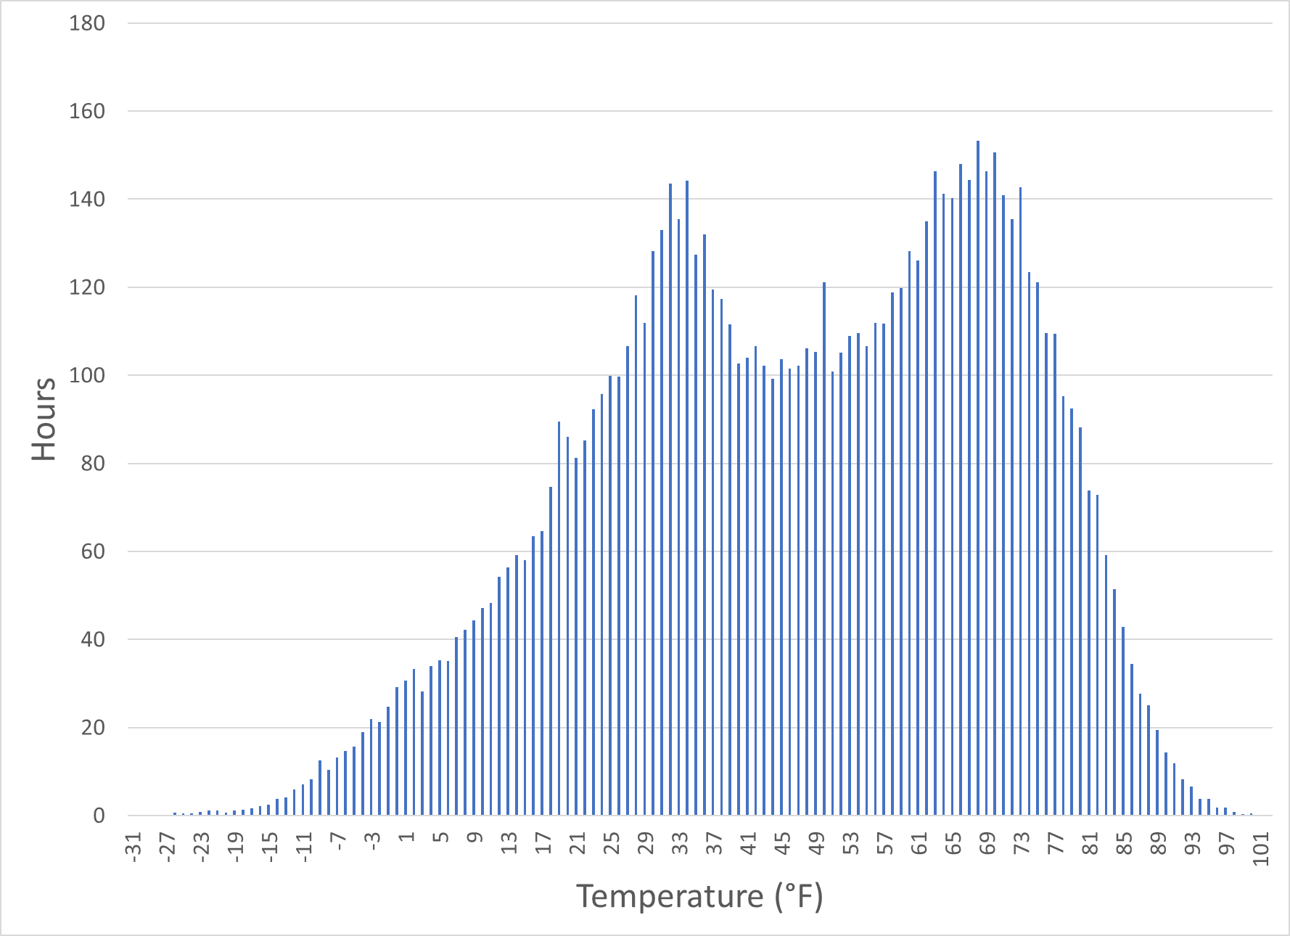
Design Conditions
MSP
MN
9.96%
2.58%
15°F
1.26%
0°F
-5°F
Source: ASHRAE Weather Data Viewer, for MSP

Slide 52
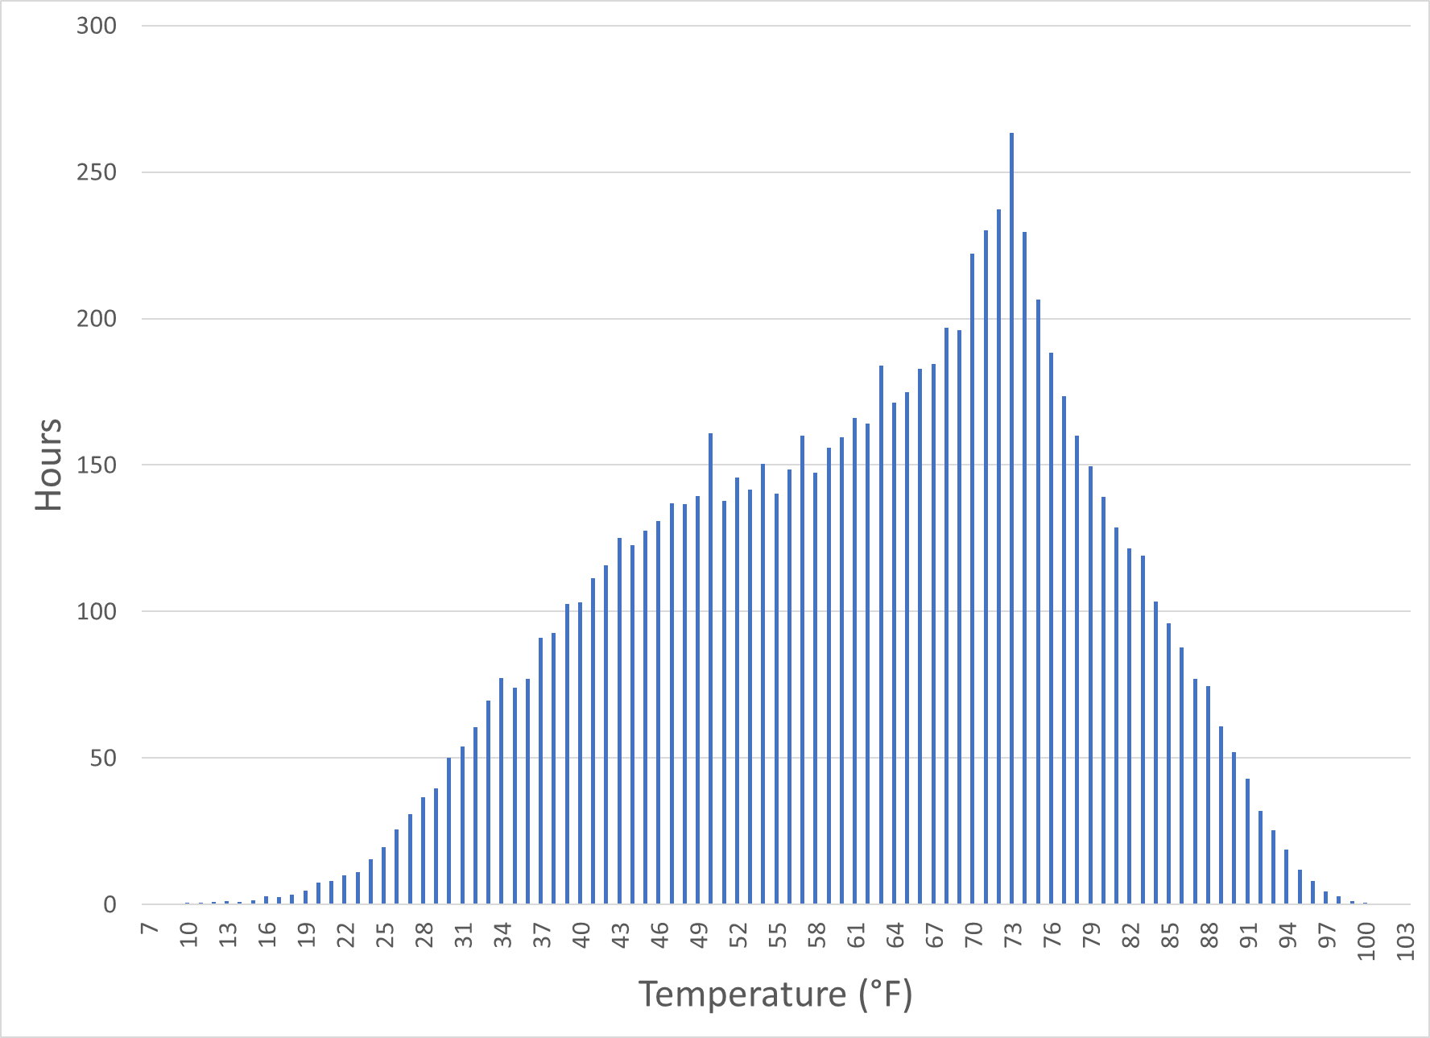
Design Conditions
CLT
NC
0.305%
0.067%
20°F
15°F
Source: ASHRAE Weather Data Viewer, for CLT

Slide 53
Selecting Heat Pumps
Heat Load
Heat Pump
+
Supplemental
Heat Pump
Capacity
-10°F
0F
15°F
30°F
45°F
Outdoor Air Temperature
© 2025 Daikin Applied

Slide 54
Heat Pump Heating Emissions – Minnesota
Assumptions
Natural Gas Efficiency: | 85%
Electric Resistance Efficiency: | 99%
Grid Emissions Factor: (lb/MWh) | 752
Natural Gas Emissions (lbs/therm) | 12.1
Elect. Heat
Nat. Gas
Emissions Changeover
Heat Pump
Increasing Efficiency
Emissions changeover varies with grid emissions factors, available from US EPA eGRID

Slide 55
Heat Pump Heating Emissions – Minnesota
Assumptions
Natural Gas Efficiency: | 85%
Electric Resistance Efficiency: | 99%
Electricity Cost: ($/kWh) | $0.12
Natural Gas Cost: ($/mcf) | $8.61
Elect. Heat
Cost Changeover
Nat. Gas
Heat Pump
Increasing Efficiency
Cost changeover point varies with utility rates, available from US EIA and utilities

Slide 56
Heat Pump Heating Emissions – North Carolina
Assumptions
Natural Gas Efficiency: | 85%
Electric Resistance Efficiency: | 99%
Grid Emissions Factor: (lb/MWh) | 626
Natural Gas Emissions (lbs/therm) | 12.1
Elect. Heat
Nat. Gas
Emissions Changeover
Heat Pump
Increasing Efficiency
Emissions changeover varies with grid emissions factors, available from US EPA eGRID

Slide 57
Heat Pump Heating Emissions – North Carolina
Assumptions
Natural Gas Efficiency: | 85%
Electric Resistance Efficiency: | 99%
Electricity Cost: ($/kWh) | $0.11
Natural Gas Cost: ($/mcf) | $10.12
Elect. Heat
Cost Changeover
Nat. Gas
Heat Pump
Increasing Efficiency
Cost changeover point varies with utility rates, available from US EIA and utilities

Slide 58


Cold Climate Considerations
Colder climates are a challenge for HPs
    Gas density
    Motor cooling
    Capacity / efficiency
Higher LWT Operation
  Reduces HP efficiency
  Increases lift
To operate HPs in cold climates, you need to do any/all of these:
  Reduce the load
  Recover energy
  Lower the hot water temperature
  Share the lift
Temp
Capacity
Load & Lift
© 2025 Daikin Applied

Slide 59
Why High LWT HPs Aren’t The Perfect Answer
Historically, high heating water temperature wasn’t such a big deal
  Limited impact on gas / electric resistance efficiency
  Minimizes coil and pipe sizes
  Many systems use 180°F or warmer hot water, or steam
Retrofitting these systems with heat pumps may be more difficult
  Heat pumps are lift sensitive; the warmer the hot water, the worse the efficiency and capacity
  Lower supply temperature is more efficient, but may require new pipe and heating coils
  Simply retrofitting high temperature heat pumps may not be the best overall option if environmental concerns are a design goal
Not all heat pump systems are equally difficult to retrofit
  Rooftop units may be much easier to convert from gas to heat pump than high temperature hot water systems
  The main changes on RTUs are larger electrical service and unit size
Heat Pump ≠ Boiler
©2024 Daikin Applied

Slide 60
Retrofitting Package Rooftop HPs
Existing Unit
Rooftop w/ Gas Heat
 | Existing Unit
MCA | 130A – 1/0 AWG
MOP | 150
New ASHP Rooftop Unit
 | Scenario 1: Std Heat Pump | Scenario 2: Inverter Heat Pump | Scenario 3: Inverter HP Dual-point Electrical
MCA | 280 amps – 300 MCM | 233 amps – 4/0 AWG | C1: 130A 1/0 AWG C2: 100A 3 AWG
MOP | 300 amps | 250 amps | C1 150A / C2 = 125A
Install Requirements | New 280A Feed (+6 wire sizes) | New 233A Feed (+3 wire sizes) | Use existing 130A Feed, New 100A Feed
Relative Electrical Install Cost | High | Medium | Low
© 2025 Daikin Applied

Slide 61
Retrofitting Package Rooftop HPs
Existing Unit
Rooftop w/ Gas Heat
 | Existing Unit
MCA | 130A – 1/0 AWG
MOP | 150
New ASHP Rooftop Unit
 | Scenario 1: Std Heat Pump | Scenario 2: Inverter Heat Pump | Scenario 3: Inverter HP Dual-point Electrical
MCA | 280 amps – 300 MCM | 233 amps – 4/0 AWG | C1: 130A 1/0 AWG C2: 100A 3 AWG
MOP | 300 amps | 250 amps | C1 150A / C2 = 125A
Install Requirements | New 280A Feed (+6 wire sizes) | New 233A Feed (+3 wire sizes) | Use existing 130A Feed, New 100A Feed
Relative Electrical Install Cost | High | Medium | Low
© 2025 Daikin Applied

Slide 62
Retrofitting Package Rooftop HPs
Existing Unit
Rooftop w/ Gas Heat
 | Existing Unit
MCA | 130A – 1/0 AWG
MOP | 150
New ASHP Rooftop Unit
 | Scenario 1: Std Heat Pump | Scenario 2: Inverter Heat Pump | Scenario 3: Inverter HP Dual-point Electrical
MCA | 280 amps – 300 MCM | 233 amps – 4/0 AWG | C1: 130A 1/0 AWG C2: 100A 3 AWG
MOP | 300 amps | 250 amps | C1 150A / C2 = 125A
Install Requirements | New 280A Feed (+6 wire sizes) | New 233A Feed (+3 wire sizes) | Use existing 130A Feed, New 100A Feed
Relative Electrical Install Cost | High | Medium | Low
© 2025 Daikin Applied

Slide 63
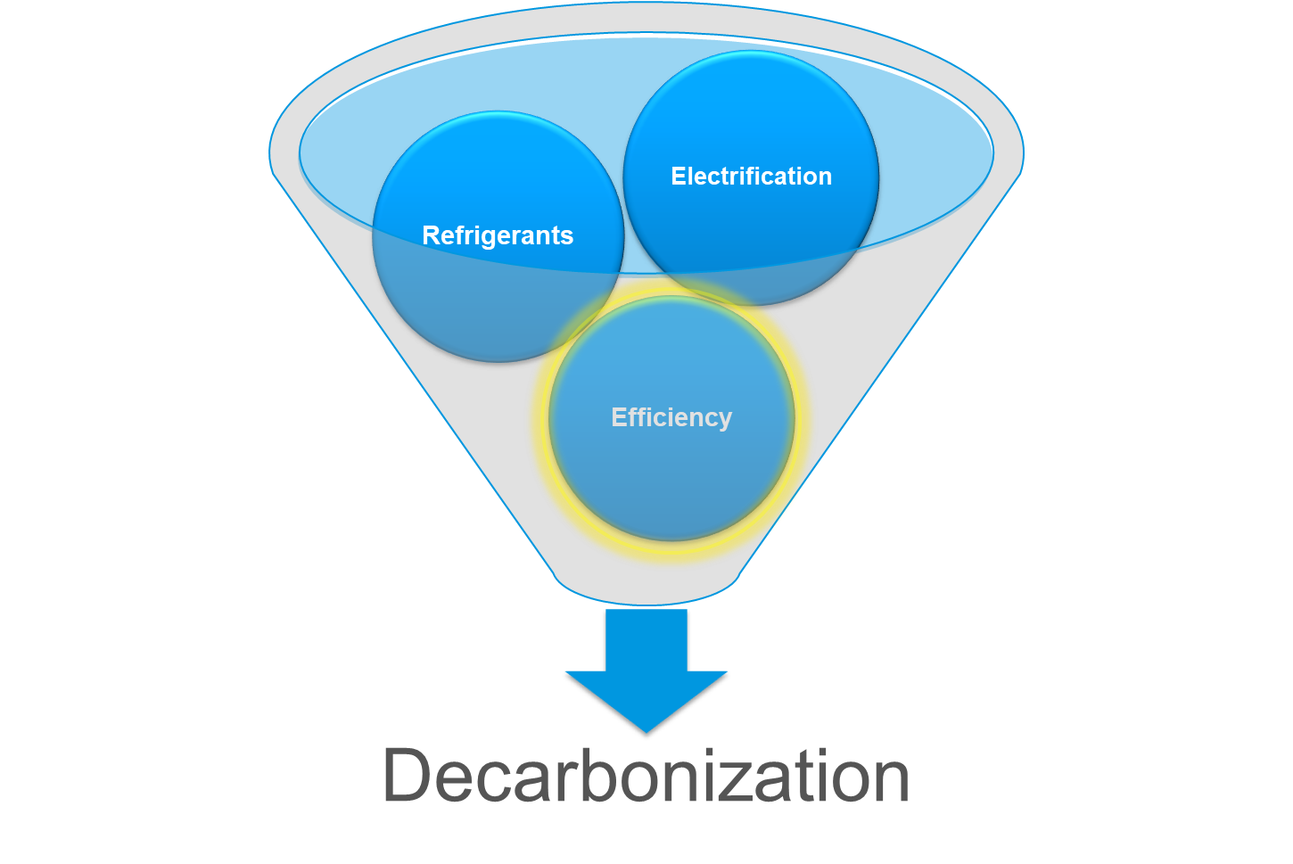
Equipment & System Efficiency
© 2025 Daikin Applied

Slide 64
Cascade and geothermal Systems
© 2025 Daikin Applied

Slide 65
Cascade System
Sharing the lift
Improves air-to-water heat pump low ambient performance
Share and store energy in the building for comfort or domestic hot water needs
95°F
145°F
Air to Water HP
Intermediate
Loop
Water to Water HP
© 2025 Daikin Applied

Slide 66
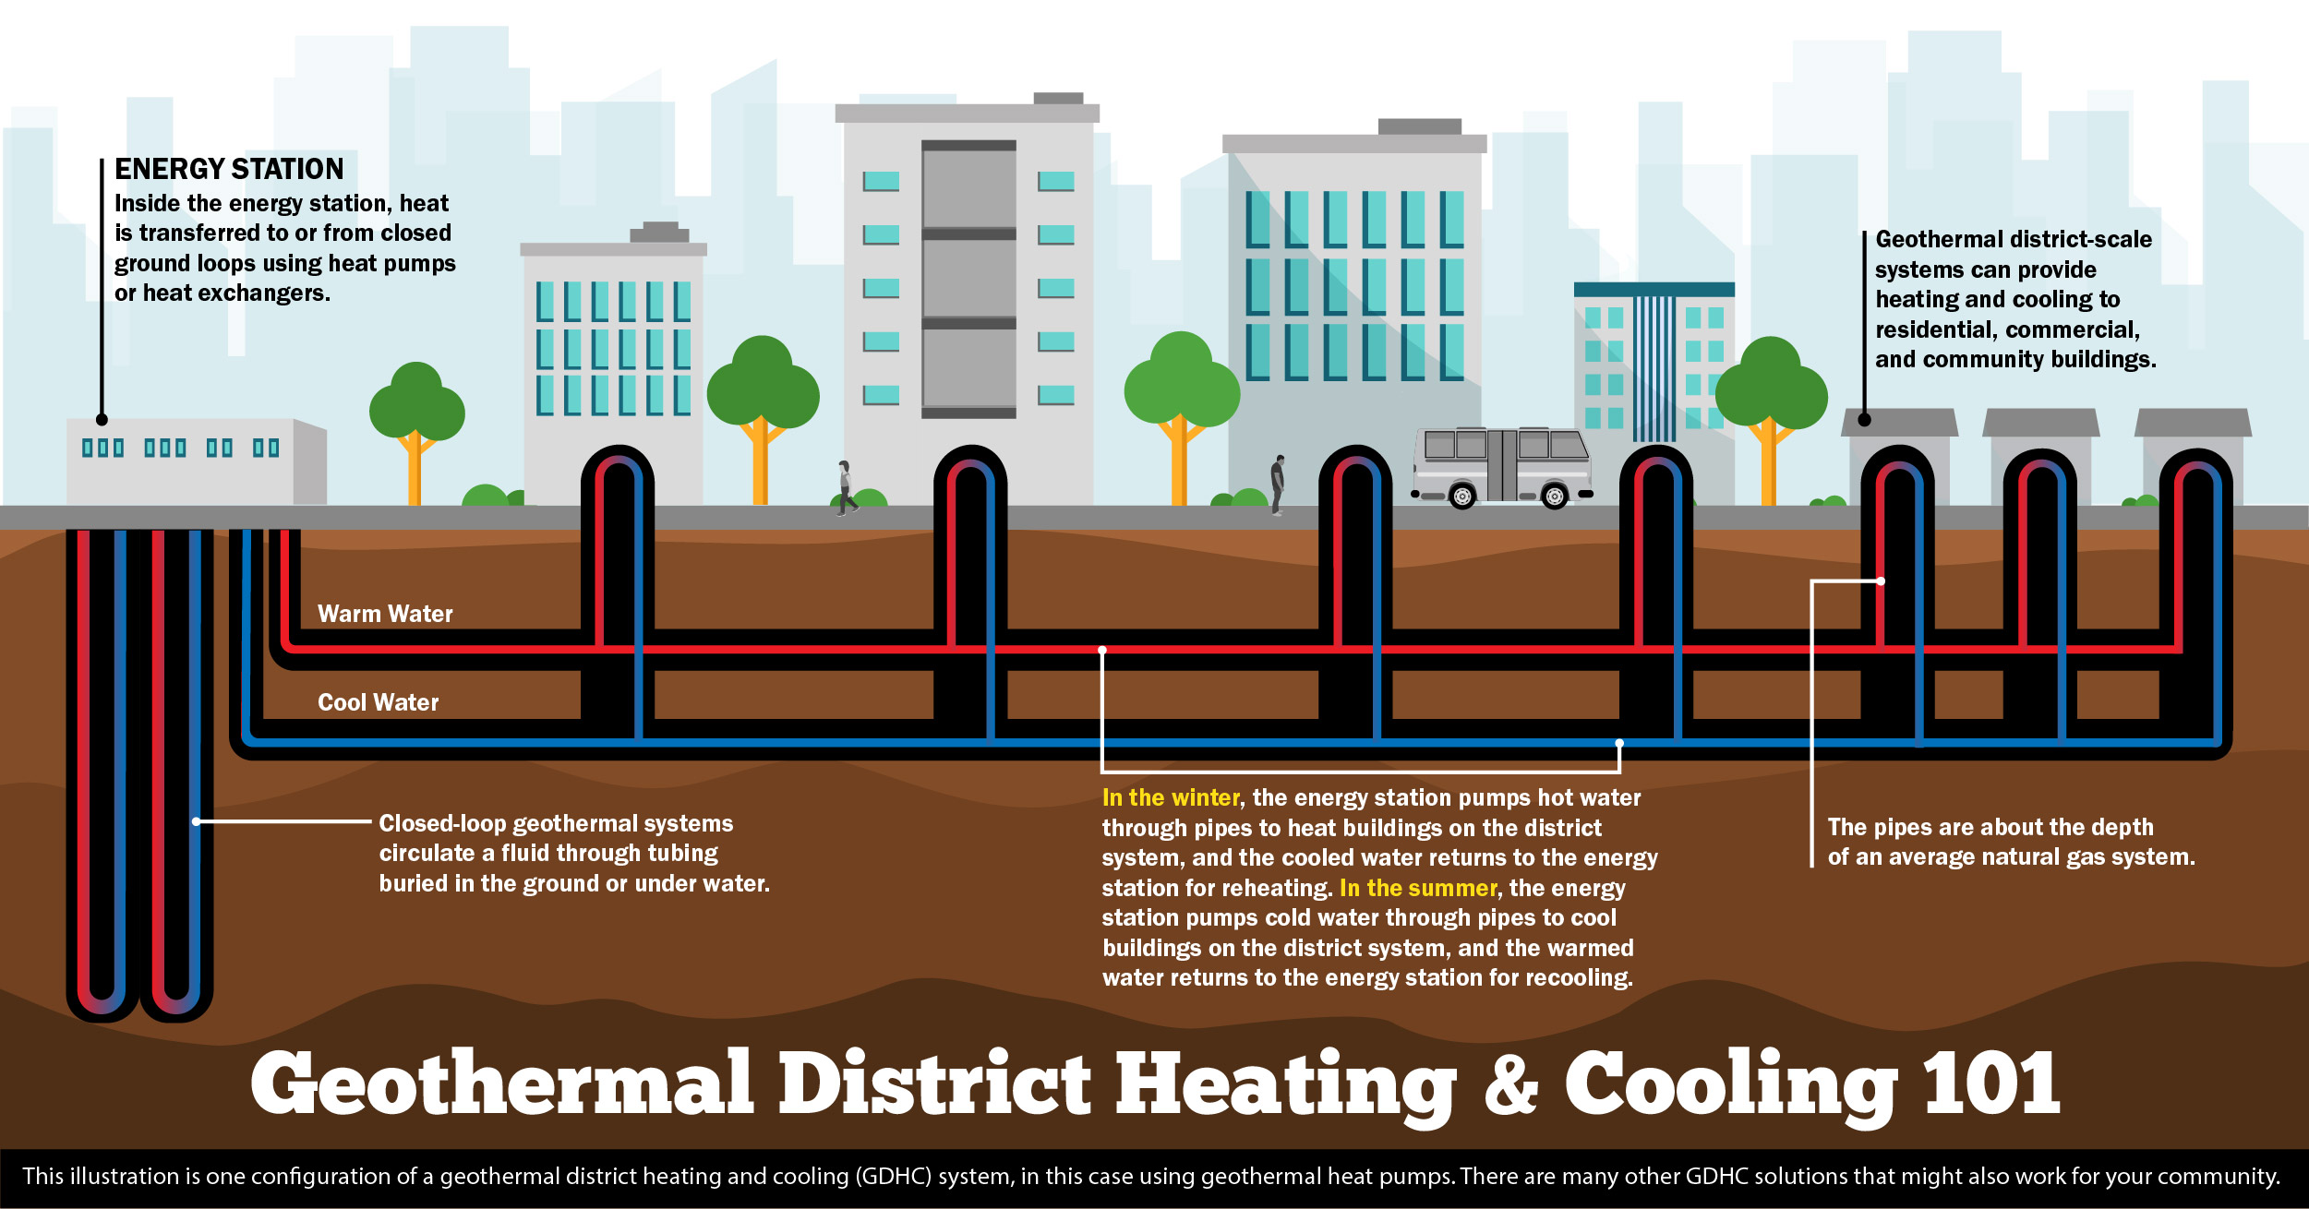
Geothermal District Heating & Cooling
Avoids air source heat pump challenges
Shares heat between buildings
Could combine with data centers for heating
Potential funding:
  Utility incentives
  Tax credits
  DOE programs
© 2025 Daikin Applied

Slide 67
Load Reduction through ventilation optimization
© 2025 Daikin Applied

Slide 68
IAQ & Energy: A Balancing Act
IAQ
Filtration
Ventilation
EUI
Cooling
Heating
Energy
Dilution
VRP

Slide 69
IAQ & Energy: A Balancing Act
IAQ
Filtration
Ventilation
EUI
Cooling
Heating
Energy
IAQP
Achieve a Better Balance
Between IAQ and Energy Performance

Slide 70
IAQP: More Outside Air = More Carbon Emissions and Cost
How buildings ensure good indoor air quality today…
…results in higher emissions & more cost
Larger and more expensive HVAC systems
Higher energy use and carbon emissions
Increased operating costs
What if the outside air is polluted?
More conditioned outside
air to “refresh” indoor air
Better indoor air quality
Relying on only outside air ventilation to deliver good indoor air quality is energy intensive and costly in many climates

Slide 71
ASHRAE Allows for Less Outside Air with Air Scrubbing
ASHRAE Standard 62.1 includes two mechanical ventilation procedures:
 | Ventilation Rate Procedure (VRP) | Indoor Air Quality Procedure (IAQP)
Methodology | Prescriptive: Outside air based on area and occupancy without accounting for air cleaning. | Performance-based: Outside air based on IAQ design targets and source-control and removal measures.
Indoor Air Quality | Depends on quality of outside air and any unusual indoor air contaminates. | Equivalent or better than VRP, especially when outside air is polluted or unusual contaminants.
Energy Intensity | Higher in many climate zones because IAQ is achieved using only outside air. | Often lower because a portion of the outside air may be replaced with cleaned indoor air.
“The IAQP may allow for a more cost-effective solution to providing good air quality, as all design strategies may be considered and compared...” - Standard 62.1-2019 User’s Manual, Pg. 100
© 2025 Daikin Applied

Slide 72
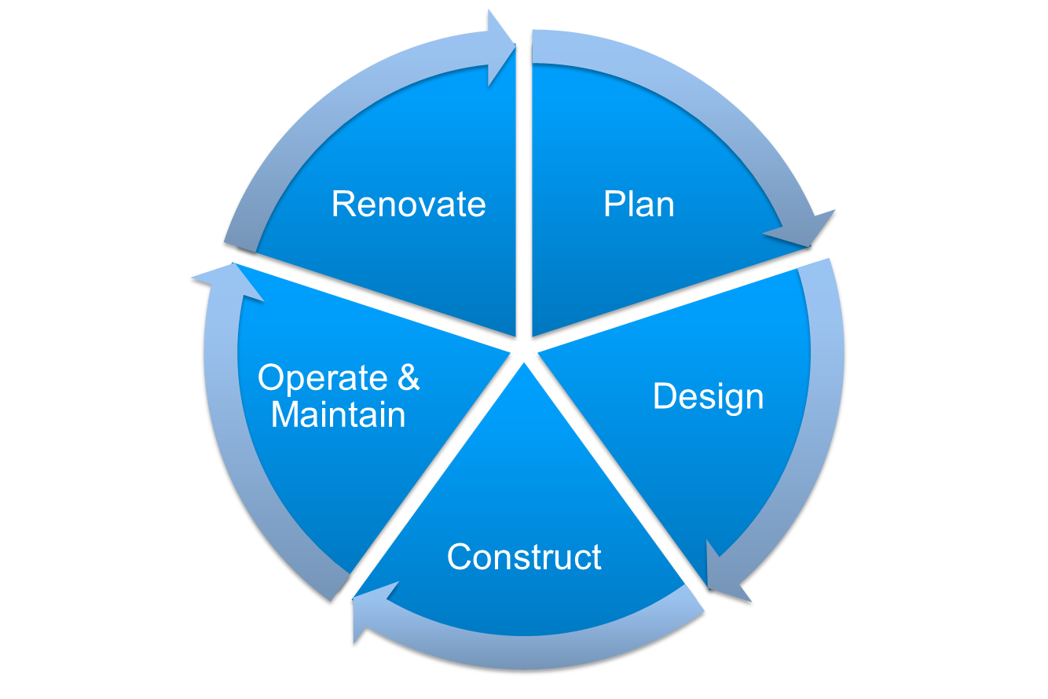
Building Life-Cycle Impact

Slide 73
Building Life-Cycle Impact
Engineer
Owner
Contractor
Facility Manager
Occupant

Slide 74
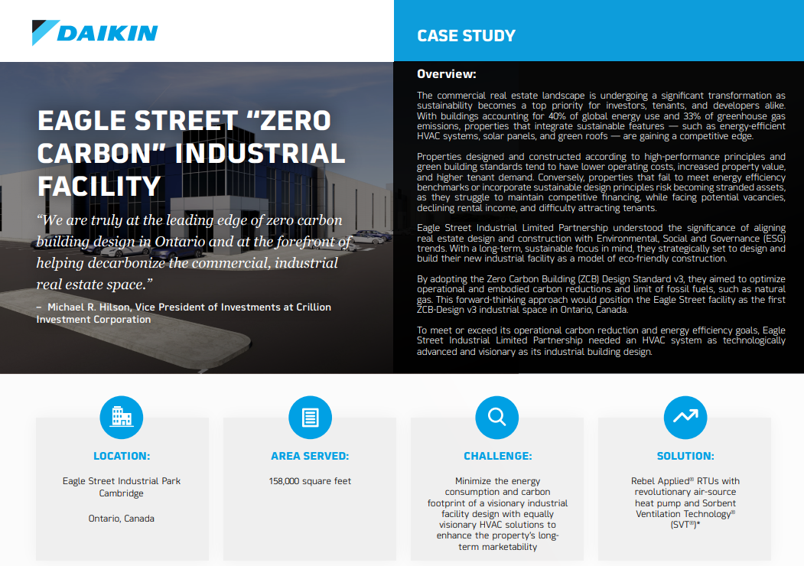

RTU Heat Pump Case Study
Eagle Street Industrial Facility
Toronto
New construction
Industrial/logistical warehouse
CaGBC Zero Carbon Building Design Standard V3
Rooftop unit heat pumps with
    R-32 refrigerant
    Optimized ventilation
    Supplemental gas heat
© 2025 Daikin Applied

Slide 75

Where Can I Go for Information?

Slide 76


Where Can I Go for Information?
Selected Resources
Daikin Applied: The Paths to Decarbonization
ASHRAE
  Center of Excellence for Building Decarbonization
  Building Decarb 101
US Department of Energy: Decarbonizing the U.S. Economy by 2050: A National Blueprint for the Buildings Sector
Decarbonization Guides
  Decarbonizing Building Thermal Systems: A How-To Guide for Applying Heat Pumps and Beyond
Pathways to Commercial Liftoff: Geothermal Heating and Cooling

Slide 77

Questions & Key Takeaways
Key Takeaways
Three levers for decarbonization of HVAC systems
    Electrification, efficiency, refrigerants
  Heat pumps are work in progress
    Improving unit operating envelope
  Optimize the system
    Lower the hot water temperature
    Consider COP, emissions and cost
    Apply dual fuel / supplemental heat where it makes sense
  Share the lift, share the energy
    Cascade systems; district energy systems; heat recovery
  Reduce the load
    Optimize ventilation with IAQP

Slide 78
Thank you for your time and attention
For more information, contact:
Jeff Seewald
jeffrey.seewald@daikinapplied.com

Slide 79
Building Life-Cycle Impact
Plan
Design
Construct
Operate & Maintain
Renovate

